Slide 1
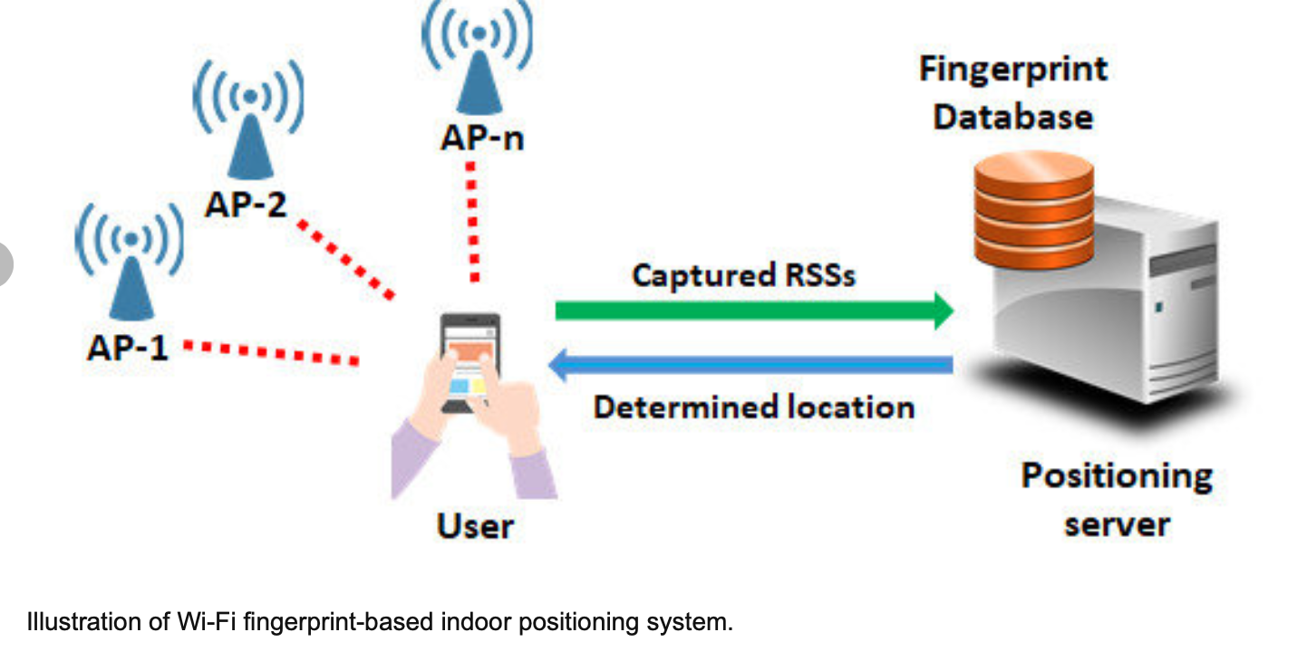

Wi-Fi Fingerprint-Based Indoor Positioning System

Slide 2
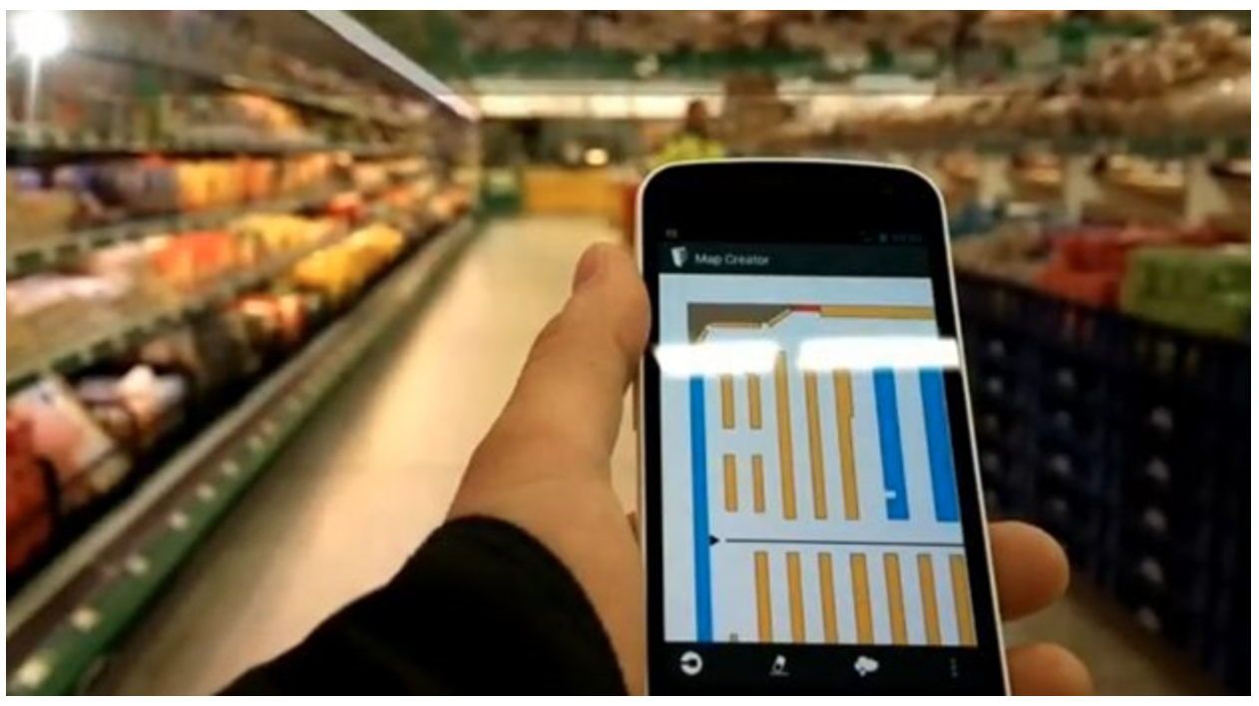
Agenda
Pre-processing Steps
Dimension Reduction – Determining the Building to Use
Dimension Reduction – Determining the WAPs to include
Comparison of Summary Metrics for 12 Trained Models
Random Forest, C5.0, and k-Nearest Meighbors for each of the Following Sub-Groups
70% of WAPs
80% of WAPs
90% of WAPs
100% of WAPs
Final Model Selection

Slide 3
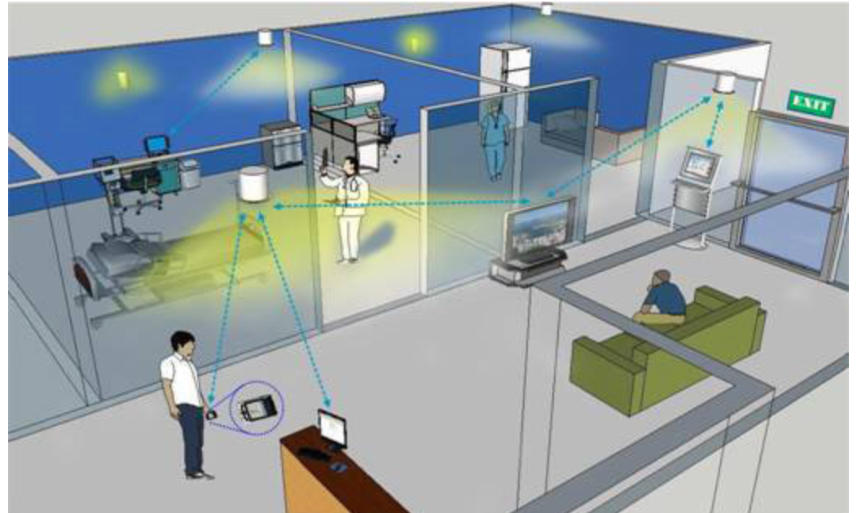
Agenda (cont.)
Recommendations for Data Improvement
Other Indoor Positioning Techniques
Appendix ogf R Code Used
GOAL – Investigate the feasibility of using Wifi fingerprints to determine a person’s location indoors.

Slide 4
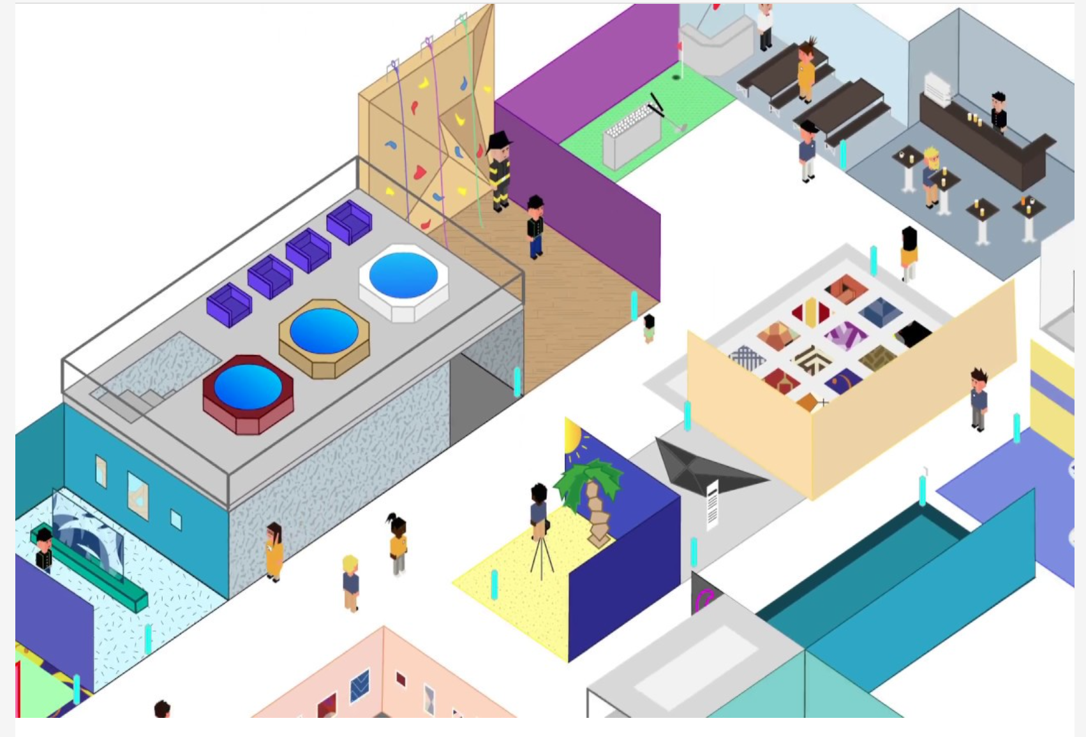
Preprocessing Steps
Saved the training data as an Excel workbook
For ease of analysis, cut the following attributes from the end of the spreadsheet and insert them at the beginning
FLOOR
BUILDINGID
SPACEID
RELATIVEPOSITION
Delete the following attributes which are not needed
LONGITUDE
LATITUDE
USERID
PHONEID
TIMESTAMP
Performed dimension reduction on the data set (details on the next slides)
Determine the building with the most observations where all WAPs do not equal 100
Determine the WAPs to include that have the fewest entries equal to 100

Slide 5
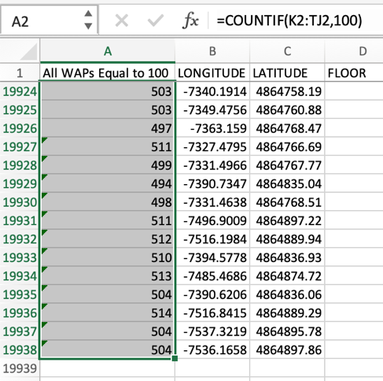
DR - Steps for Guiding Principle #1 - Determining the Building
Per observation, count number of WAPS with an entry of “100”
Insert a blank column at the beginning of the worksheet and title it “All WAPs Equal to 100”
Use a “COUNTIF” formula to do the count
Range – columns WAP001 thru WAP520
Criteria – 100
Example – COUNTIF(K2:TJ2,100)
Copy and paste the formula down the entire column to the very last row containing an observation

Slide 6
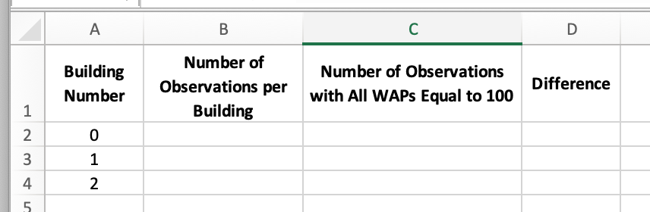
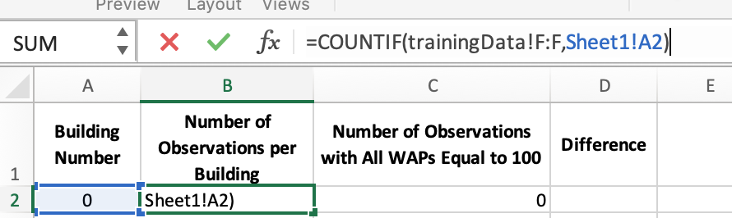
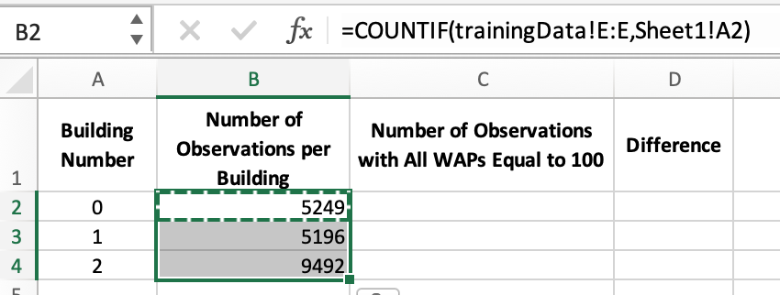
DR - Steps for Guiding Principle #1 - Determining the Building
Create a chart on blank worksheet to do building counts
Set up the following chart in columns A, B, C, and D
In column B, use a “COUNTIF” formula to count the number of observations per building
Range – “BUILDINGID” column on “trainingData” sheet
Criteria - “Building Number” shown in chart
Copy and paste this formula down to rows 3 and 4 of column B

Slide 7
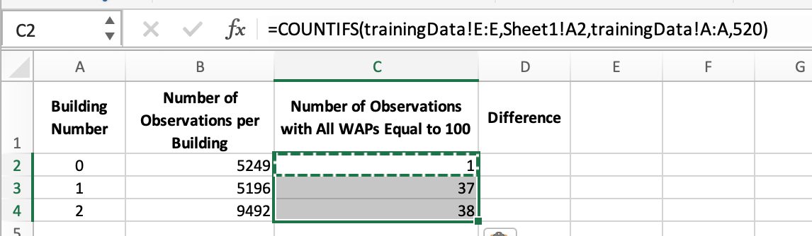
DR - Steps for Guiding Principle #1 - Determining the Building
Create a chart on blank worksheet to do building counts (cont.)
Use a “COUNTIFS” formula to count number of observations per building with all WAPs equal to 100 sheet
Range 1 – “BUILDINGID” column on the “trainingData” sheet
Criteria 1 – “Building Number” shown in chart
Range 2 – “All WAPs Equal to 100” column on the “trainingData” sheet
Criteria 2 – 520 which is the total number of WAPs on the “trainingData” sheet
Copy and paste down to rows 3 and 4 in column C

Slide 8
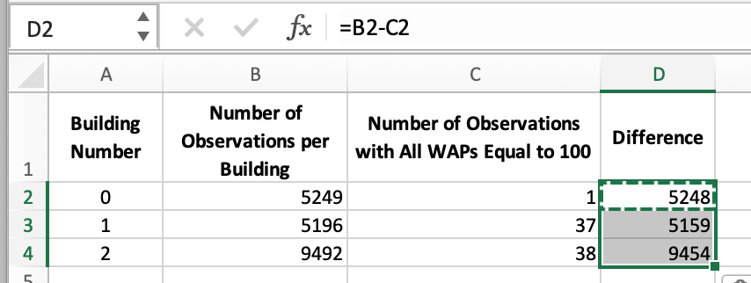
DR - Steps for Guiding Principle #1 - Determining the Building
Create a chart on blank worksheet to do building counts (cont.)
In column D, calculate number of observations per building where all the WAPs are NOT equal to 100
Difference between columns B and C
Copy and paste the formula down rows 3 and 4 in column D
Building number 2 has the most observations at 9,454. So, it will be the one used to create the models in RStudio

Slide 9
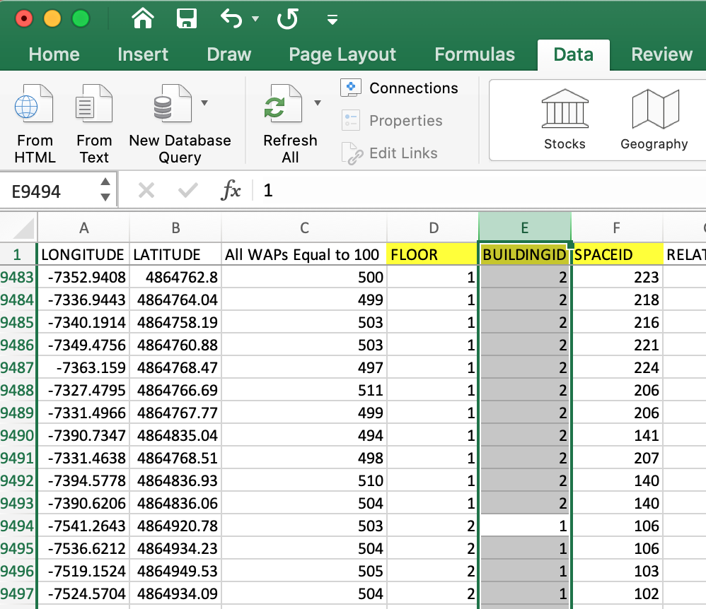
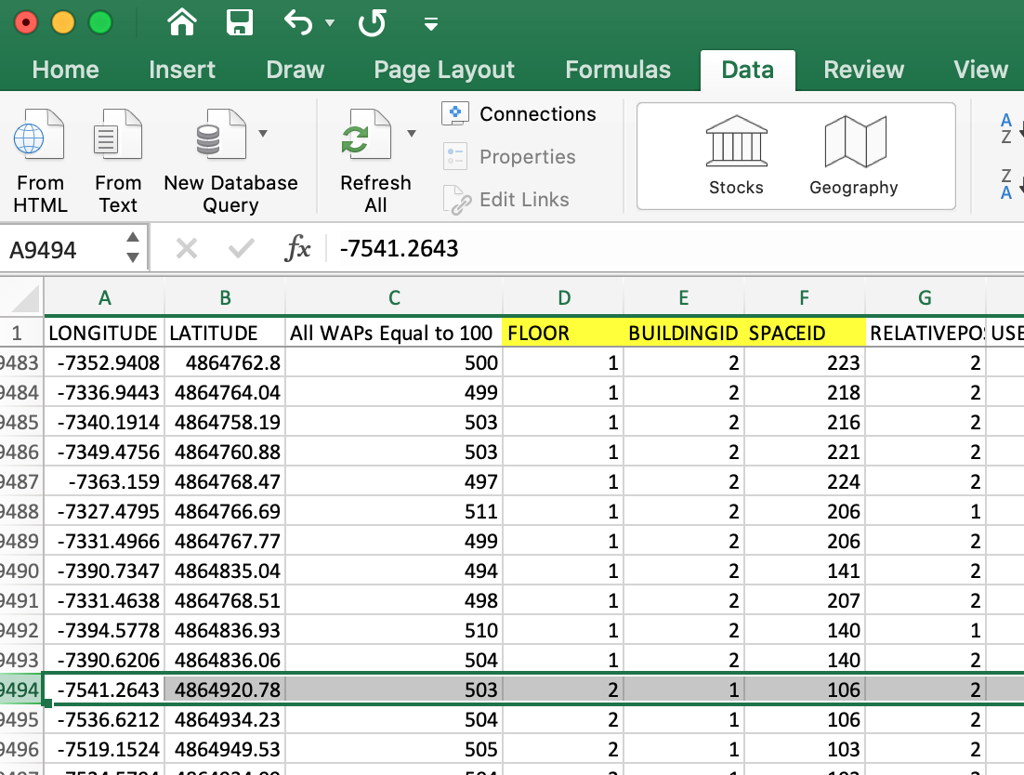
DR - Steps for Guiding Principle #1 - Determining the Building
Isolate the observations from building number 2
Sort the “trainingData” sheet by the “BUILDINGID” column in descending order
Highlight the “BUILDINGID” column and find the first occurrence of building “1”
Highlight the row where the first “1” occurs

Slide 10
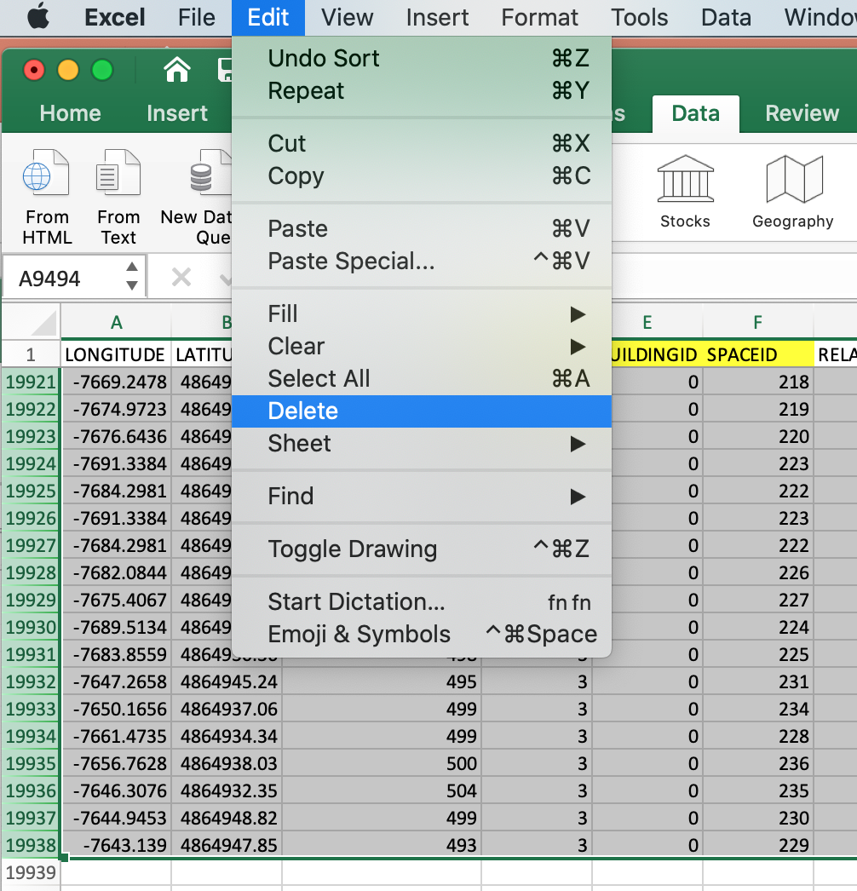
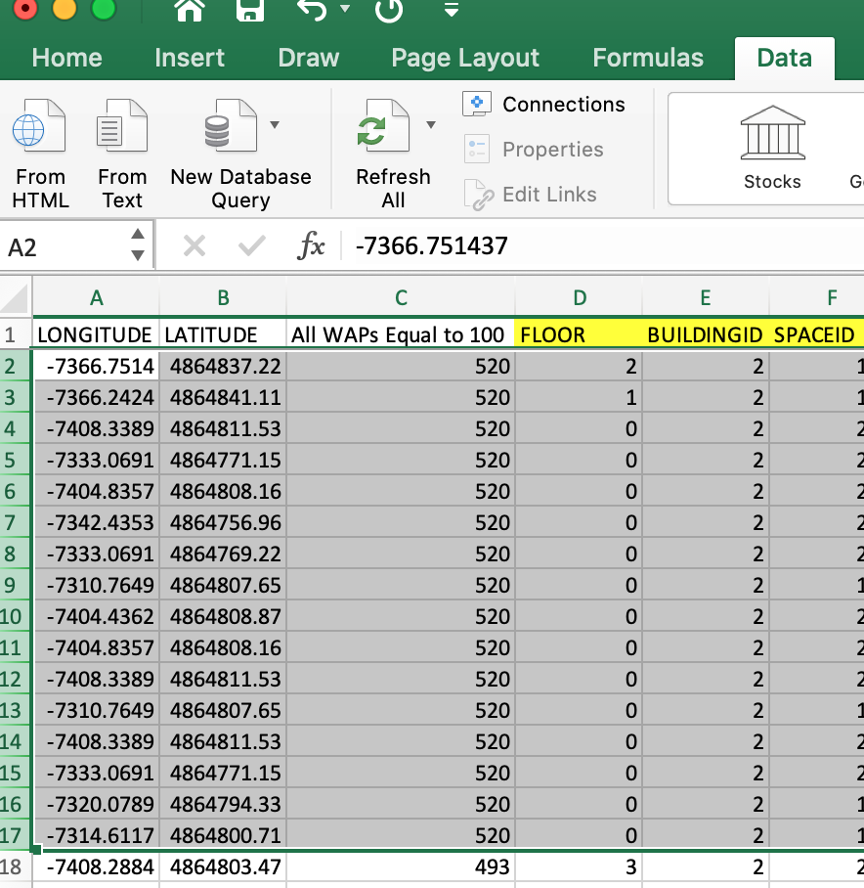
DR - Steps for Guiding Principle #1 - Determining the Building
Isolate the observations from building number 2 (cont.)
Highlight all rows from that point down to the last observation for building “0”
Delete all highlighted rows
Save the file under a new name such as “Bldg 2 Training Data”
Delete observations with 520 WAPs having an entry of 100
Sort the “trainingData” sheet by the “All WAPs Equal 100” column in descending order
Highlight and delete all of the rows that equal 520 in this column
This will leave 9,454 observations

Slide 11
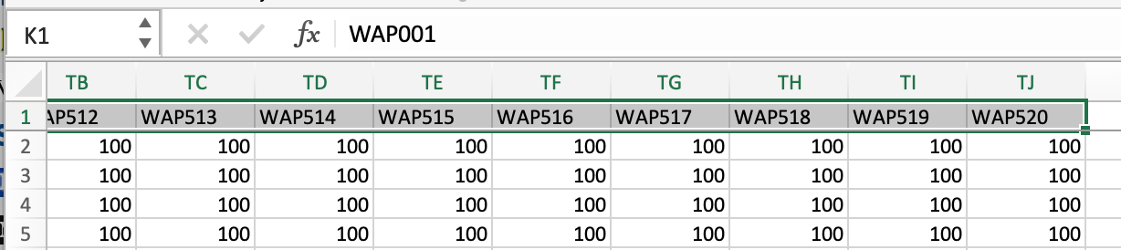
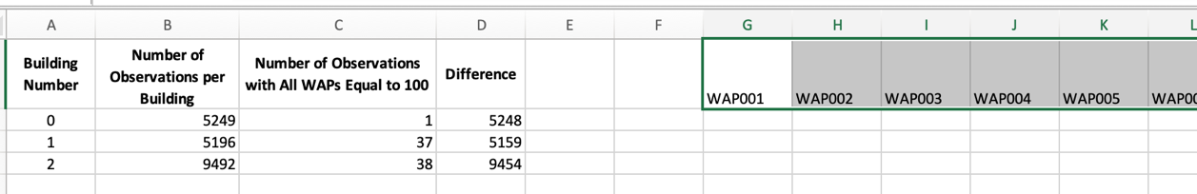
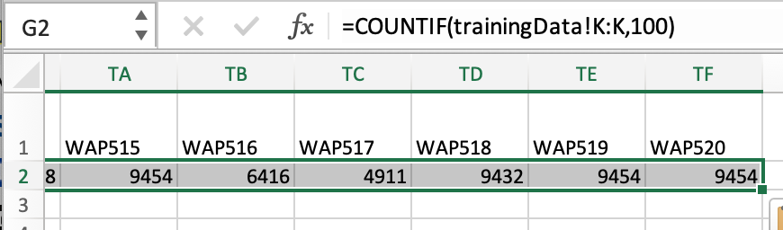
DR - Steps for Guiding Principle #2 - Determine the WAPs to Include
Steps for Determining the WAPs to include
Highlight and copy all of the WAP column headers on the “trainingData sheet”
Paste them in the column header row next to the chart created earlier on sheet 1
Use a COUNTIF formula to determine the number of entries for each WAP that equal 100
Range – WAP001 on the “trainingData” sheet
Criteria – 100
Copy and paste under each of the WAP column headers

Slide 12
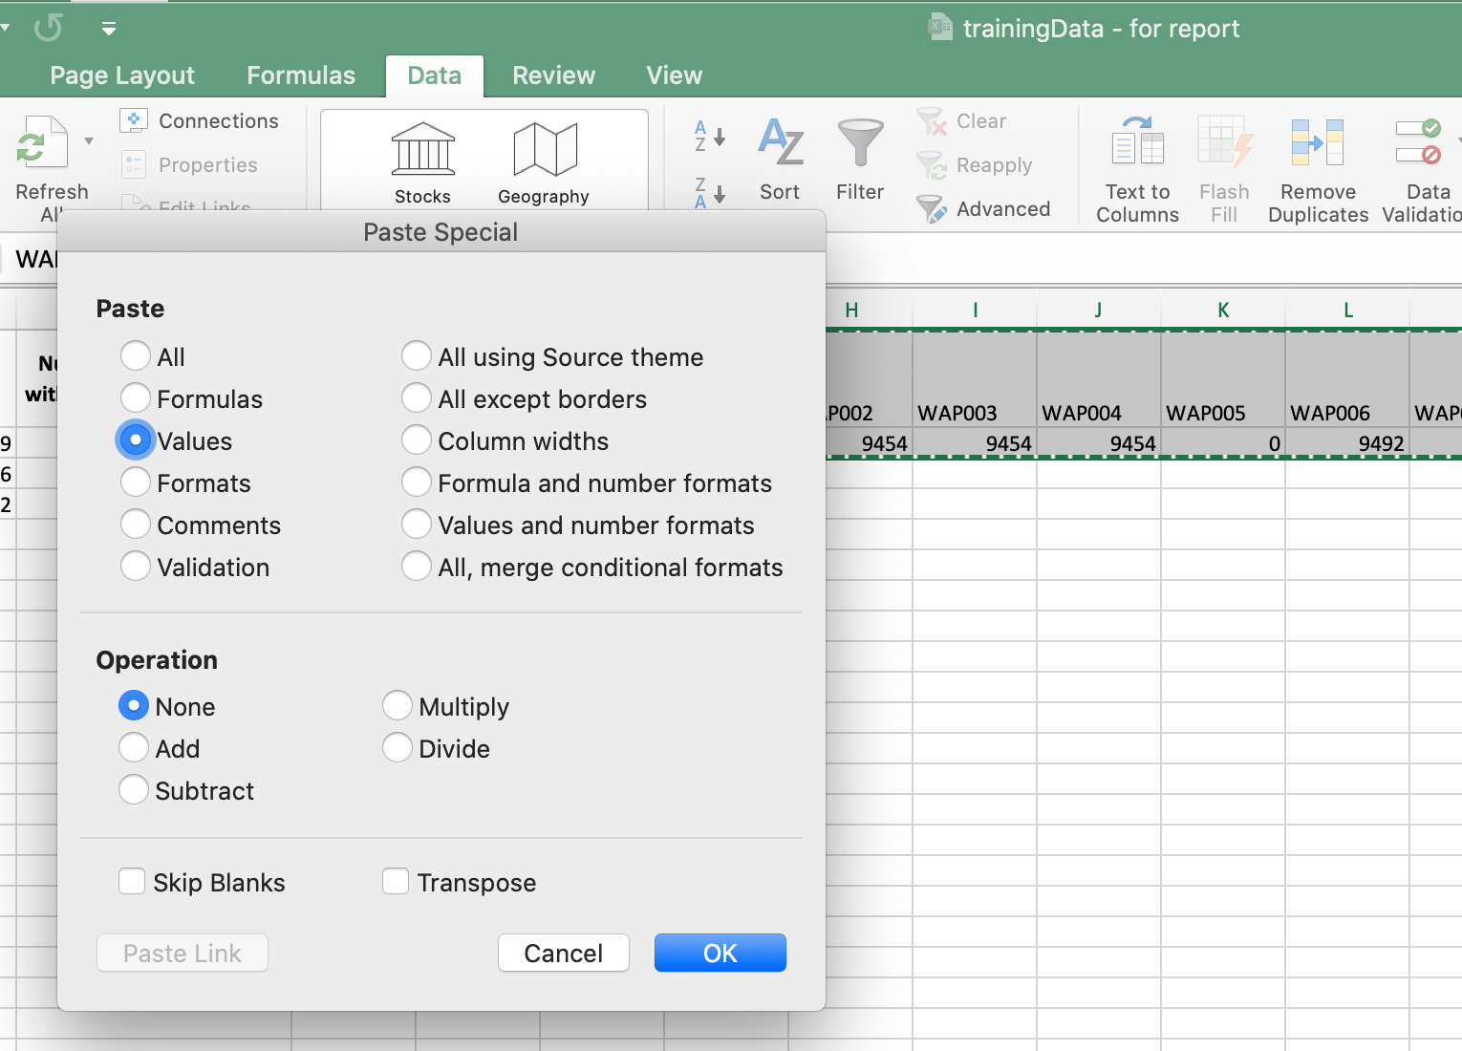
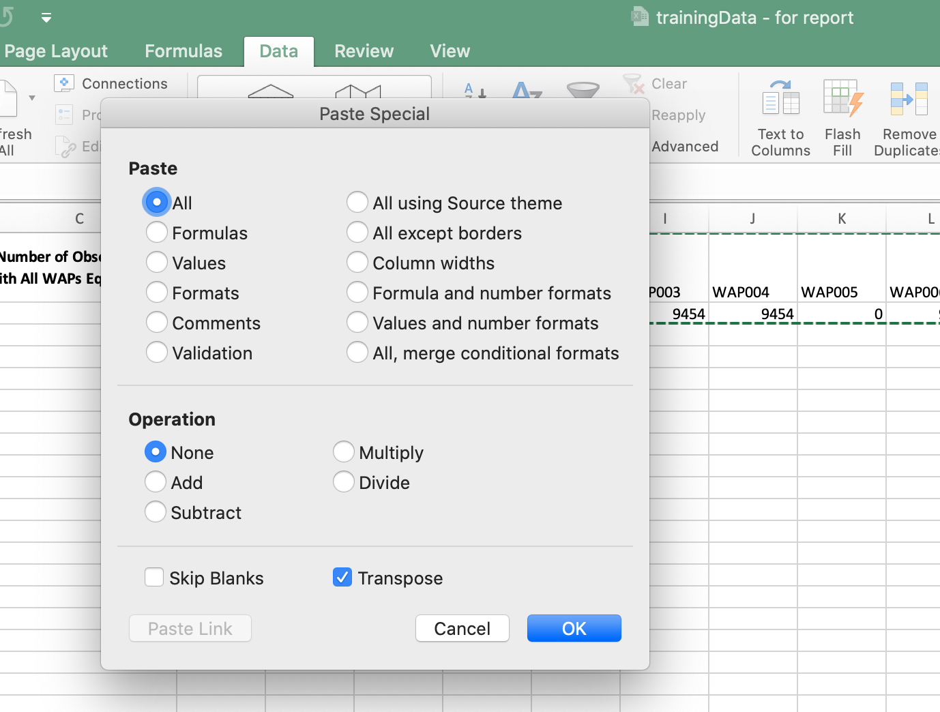
DR - Steps for Guiding Principle #2 - Determine the WAPs to Include
Steps for Determining the WAPs to include (cont.)
Highlight and copy all of the WAP column headers and counts from WAP001 to WAP520
Select ”paste special – values”
Select “copy” again
Count five cells down from the WAP001 count on sheet 1
Select “paste special – transpose”

Slide 13
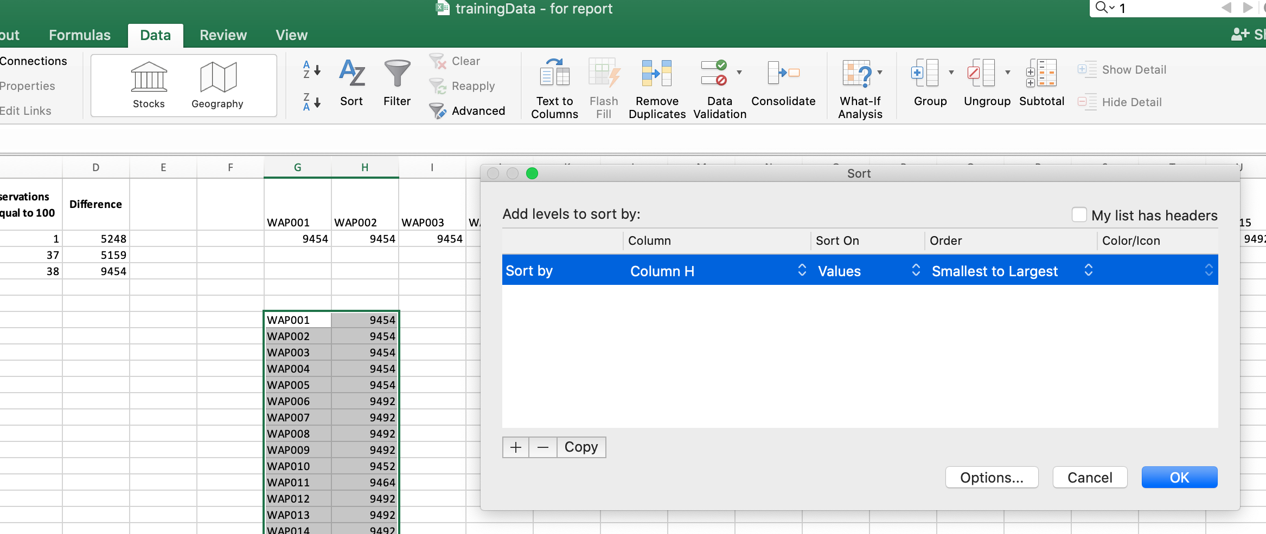
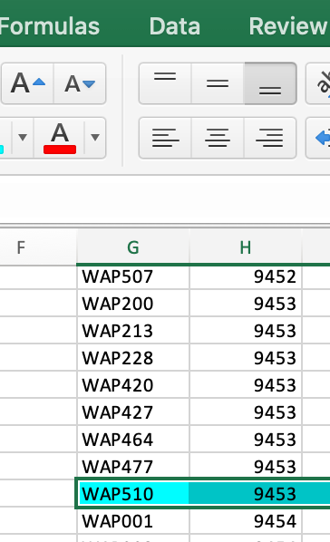
DR - Steps for Guiding Principle #2 - Determine the WAPs to Include
Steps for Determining the WAPs to include (cont.)
While the cells are still highlighted, sort the columns by the count from smallest to largest
Scroll down the list and highlight the final row that does not show all entries being 100 or a count of 9,454

Slide 14
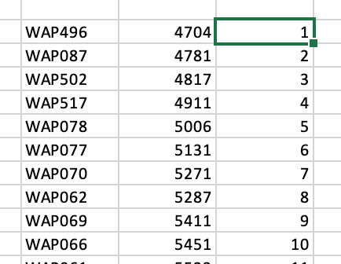
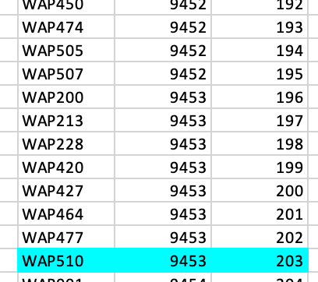
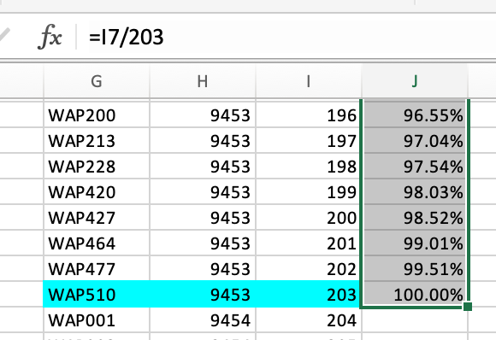
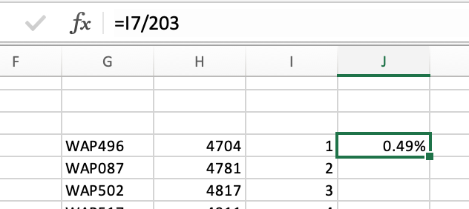
DR - Steps for Guiding Principle #2 - Determine the WAPs to Include
Steps for Determining the WAPs to include (cont.)
Do a simple count from the first WAP down to the line highlighted in the previous step
Count will equal 203
Based on the count done in the previous step, calculate a cumulative percentage

Slide 15
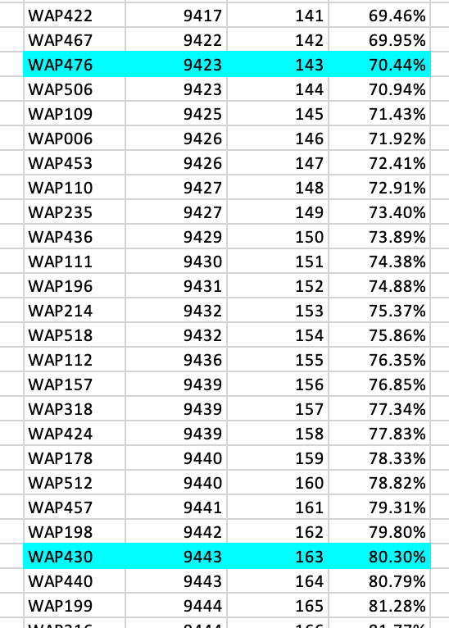
DR - Steps for Guiding Principle #2 - Determine the WAPs to Include
Steps for Determining the WAPs to include (cont.)
Mark the rows at 70%, 80%, 90%, and 100%
Percentages will be used to develop the following four data sets mentioned on the next few slides for modeling purposes

Slide 16
DR - Steps for Guiding Principle #2 - Determine the WAPs to Include
143 WAPs to include in the 70 % Data Set
WAP496, WAP087, WAP502, WAP517, WAP078, WAP077, WAP070, WAP062, WAP069, WAP066, WAP061, WAP065, WAP084, WAP085, WAP501, WAP131, WAP132, WAP064, WAP074, WAP121, WAP063, WAP122, WAP073, WAP495, WAP118, WAP516, WAP117, WAP083, WAP145, WAP082, WAP332, WAP012, WAP011, WAP144, WAP127, WAP277, WAP128, WAP389, WAP248, WAP098, WAP099, WAP489, WAP060, WAP097, WAP096, WAP059, WAP139, WAP138, WAP068, WAP478, WAP203, WAP204, WAP067, WAP511, WAP481, WAP503, WAP479, WAP249, WAP484, WAP486, WAP391, WAP335, WAP279, WAP428, WAP114, WAP286, WAP398, WAP113, WAP342, WAP483, WAP456, WAP186, WAP187, WAP234, WAP362, WAP305, WAP418, WAP413, WAP449, WAP229, WAP233, WAP439, WAP282, WAP237, WAP480, WAP165, WAP177, WAP232, WAP164, WAP108, WAP394, WAP432, WAP107, WAP315, WAP174, WAP499, WAP514, WAP513, WAP338, WAP140, WAP498, WAP176, WAP493, WAP180, WAP141, WAP175, WAP116, WAP492, WAP230, WAP369, WAP455, WAP460, WAP181, WAP115, WAP236, WAP386, WAP371, WAP260, WAP189, WAP329, WAP465, WAP508, WAP372, WAP473, WAP274, WAP435, WAP504, WAP188, WAP258, WAP146, WAP396, WAP461, WAP284, WAP340, WAP316, WAP313, WAP218, WAP147, WAP261, WAP005, WAP422, WAP467, WAP476

Slide 17
DR - Steps for Guiding Principle #2 - Determine the WAPs to Include
163 WAPs to include in the 80 % Data Set
WAP496, WAP087, WAP502, WAP517, WAP078, WAP077, WAP070, WAP062, WAP069, WAP066, WAP061, WAP065, WAP084, WAP085, WAP501, WAP131, WAP132, WAP064, WAP074, WAP121, WAP063, WAP122, WAP073, WAP495, WAP118, WAP516, WAP117, WAP083, WAP145, WAP082, WAP332, WAP012, WAP011, WAP144, WAP127, WAP277, WAP128, WAP389, WAP248, WAP098, WAP099, WAP489, WAP060, WAP097, WAP096, WAP059, WAP139, WAP138, WAP068, WAP478, WAP203, WAP204, WAP067, WAP511, WAP481, WAP503, WAP479, WAP249, WAP484, WAP486, WAP391, WAP335, WAP279, WAP428, WAP114, WAP286, WAP398, WAP113, WAP342, WAP483, WAP456, WAP186, WAP187, WAP234, WAP362, WAP305, WAP418, WAP413, WAP449, WAP229, WAP233, WAP439, WAP282, WAP237, WAP480, WAP165, WAP177, WAP232, WAP164, WAP108, WAP394, WAP432, WAP107, WAP315, WAP174, WAP499, WAP514, WAP513, WAP338, WAP140, WAP498, WAP176, WAP493, WAP180, WAP141, WAP175, WAP116, WAP492, WAP230, WAP369, WAP455, WAP460, WAP181, WAP115, WAP236, WAP386, WAP371, WAP260, WAP189, WAP329, WAP465, WAP508, WAP372, WAP473, WAP274, WAP435, WAP504, WAP188, WAP258, WAP146, WAP396, WAP461, WAP284, WAP340, WAP316, WAP313, WAP218, WAP147, WAP261, WAP005, WAP422, WAP467, WAP476, WAP506, WAP109, WAP006, WAP453, WAP110, WAP235, WAP436, WAP111, WAP196, WAP214, WAP518, WAP112, WAP157, WAP318, WAP424, WAP178, WAP512, WAP457, WAP198, WAP430

Slide 18
DR - Steps for Guiding Principle #2 - Determine the WAPs to Include
183 WAPs to include in the 90 % Data Set
WAP496, WAP087, WAP502, WAP517, WAP078, WAP077, WAP070, WAP062, WAP069, WAP066, WAP061, WAP065, WAP084, WAP085, WAP501, WAP131, WAP132, WAP064, WAP074, WAP121, WAP063, WAP122, WAP073, WAP495, WAP118, WAP516, WAP117, WAP083, WAP145, WAP082, WAP332, WAP012, WAP011, WAP144, WAP127, WAP277, WAP128, WAP389, WAP248, WAP098, WAP099, WAP489, WAP060, WAP097, WAP096, WAP059, WAP139, WAP138, WAP068, WAP478, WAP203, WAP204, WAP067, WAP511, WAP481, WAP503, WAP479, WAP249, WAP484, WAP486, WAP391, WAP335, WAP279, WAP428, WAP114, WAP286, WAP398, WAP113, WAP342, WAP483, WAP456, WAP186, WAP187, WAP234, WAP362, WAP305, WAP418, WAP413, WAP449, WAP229, WAP233, WAP439, WAP282, WAP237, WAP480, WAP165, WAP177, WAP232, WAP164, WAP108, WAP394, WAP432, WAP107, WAP315, WAP174, WAP499, WAP514, WAP513, WAP338, WAP140, WAP498, WAP176, WAP493, WAP180, WAP141, WAP175, WAP116, WAP492, WAP230, WAP369, WAP455, WAP460, WAP181, WAP115, WAP236, WAP386, WAP371, WAP260, WAP189, WAP329, WAP465, WAP508, WAP372, WAP473, WAP274, WAP435, WAP504, WAP188, WAP258, WAP146, WAP396, WAP461, WAP284, WAP340, WAP316, WAP313, WAP218, WAP147, WAP261, WAP005, WAP422, WAP467, WAP476, WAP506, WAP109, WAP006, WAP453, WAP110, WAP235, WAP436, WAP111, WAP196, WAP214, WAP518, WAP112, WAP157, WAP318, WAP424, WAP178, WAP512, WAP457, WAP198, WAP430, WAP440, WAP199, WAP216, WAP179, WAP375, WAP425, WAP454, WAP197, WAP462, WAP466, WAP195, WAP250, WAP417, WAP472, WAP509, WAP220, WAP351, WAP448, WAP471, WAP219

Slide 19
DR - Steps for Guiding Principle #2 - Determine the WAPs to Include
203 WAPs to include in the 100 % Data Set
WAP496, WAP087, WAP502, WAP517, WAP078, WAP077, WAP070, WAP062, WAP069, WAP066, WAP061, WAP065, WAP084, WAP085, WAP501, WAP131, WAP132, WAP064, WAP074, WAP121, WAP063, WAP122, WAP073, WAP495, WAP118, WAP516, WAP117, WAP083, WAP145, WAP082, WAP332, WAP012, WAP011, WAP144, WAP127, WAP277, WAP128, WAP389, WAP248, WAP098, WAP099, WAP489, WAP060, WAP097, WAP096, WAP059, WAP139, WAP138, WAP068, WAP478, WAP203, WAP204, WAP067, WAP511, WAP481, WAP503, WAP479, WAP249, WAP484, WAP486, WAP391, WAP335, WAP279, WAP428, WAP114, WAP286, WAP398, WAP113, WAP342, WAP483, WAP456, WAP186, WAP187, WAP234, WAP362, WAP305, WAP418, WAP413, WAP449, WAP229, WAP233, WAP439, WAP282, WAP237, WAP480, WAP165, WAP177, WAP232, WAP164, WAP108, WAP394, WAP432, WAP107, WAP315, WAP174, WAP499, WAP514, WAP513, WAP338, WAP140, WAP498, WAP176, WAP493, WAP180, WAP141, WAP175, WAP116, WAP492, WAP230, WAP369, WAP455, WAP460, WAP181, WAP115, WAP236, WAP386, WAP371, WAP260, WAP189, WAP329, WAP465, WAP508, WAP372, WAP473, WAP274, WAP435, WAP504, WAP188, WAP258, WAP146, WAP396, WAP461, WAP284, WAP340, WAP316, WAP313, WAP218, WAP147, WAP261, WAP005, WAP422, WAP467, WAP476, WAP506, WAP109, WAP006, WAP453, WAP110, WAP235, WAP436, WAP111, WAP196, WAP214, WAP518, WAP112, WAP157, WAP318, WAP424, WAP178, WAP512, WAP457, WAP198, WAP430, WAP440, WAP199, WAP216, WAP179, WAP375, WAP425, WAP454, WAP197, WAP462, WAP466, WAP195, WAP250, WAP417, WAP472, WAP509, WAP220, WAP351, WAP448, WAP471, WAP219, WAP469, WAP437, WAP463, WAP018, WAP212, WAP231, WAP421, WAP431, WAP450, WAP474, WAP505, WAP507, WAP200, WAP213, WAP228, WAP420, WAP427, WAP464, WAP477, WAP510

Slide 20
Models Trained

Slide 21
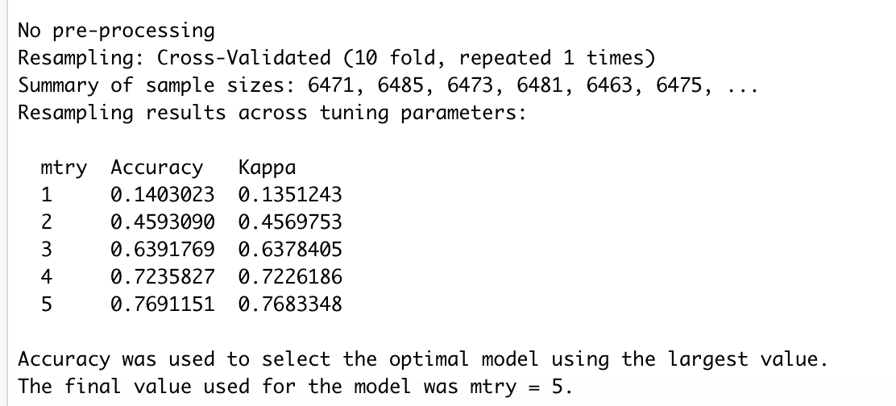
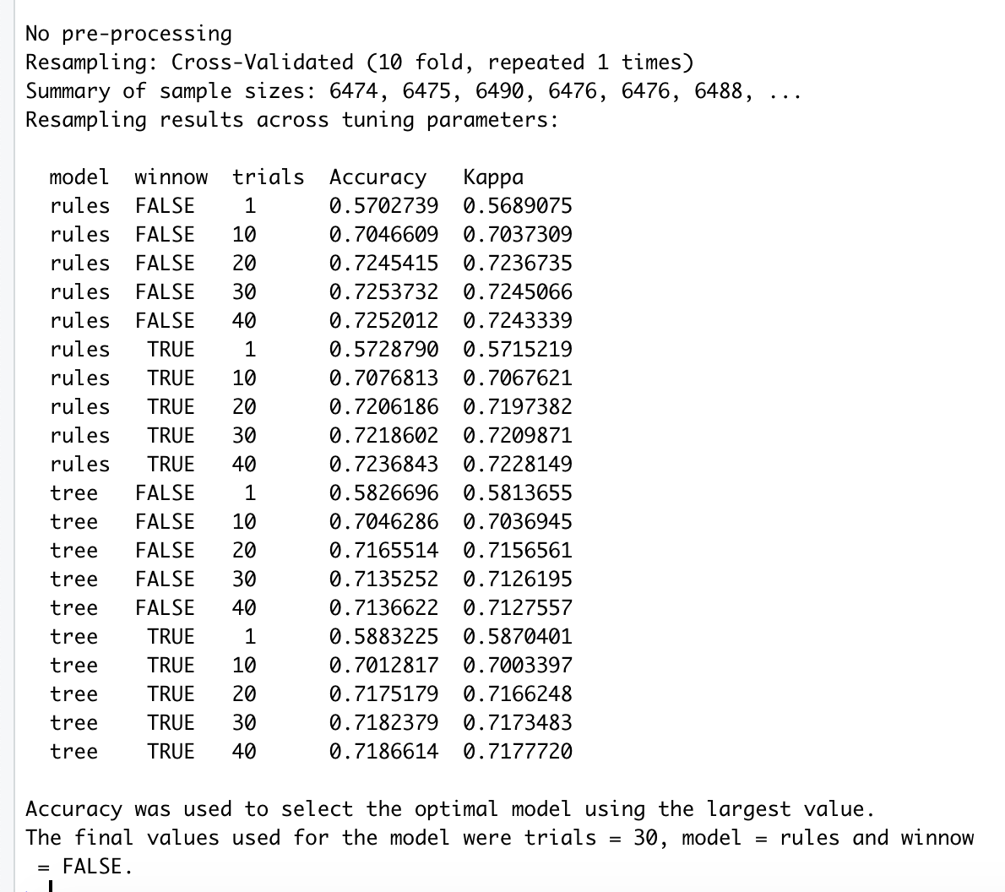
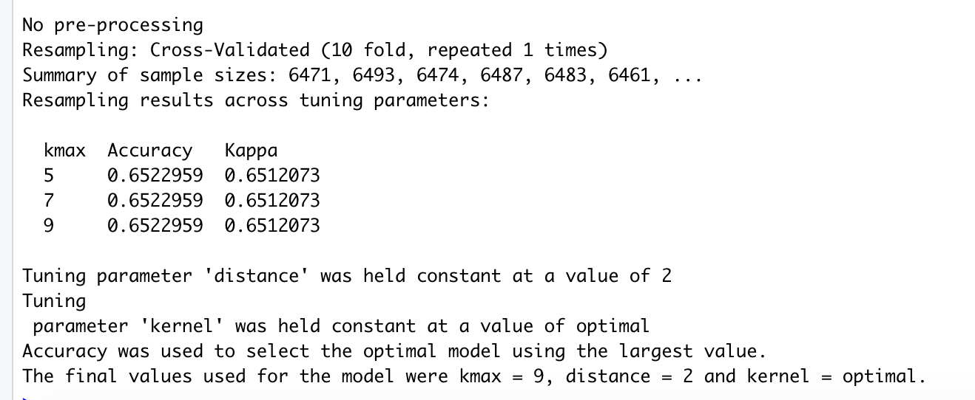
Summary Metrics for Models Using 70% of the WAPs
Random Forest Algorithm – rfFit_70
C5.0 Algorithm – C5Fit_70
k-Nearest Neighbors Algorithm – knnFit_70

Slide 22
Accuracy & Kappa for Models Using 70% of the WAPs
Both plots show the random forest model with a greater accuracy and higher kappa
Dot Plot
Box Plot

Slide 23
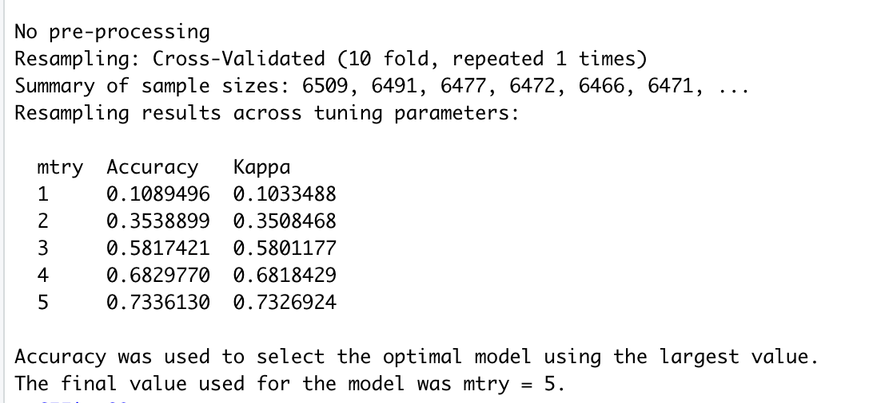
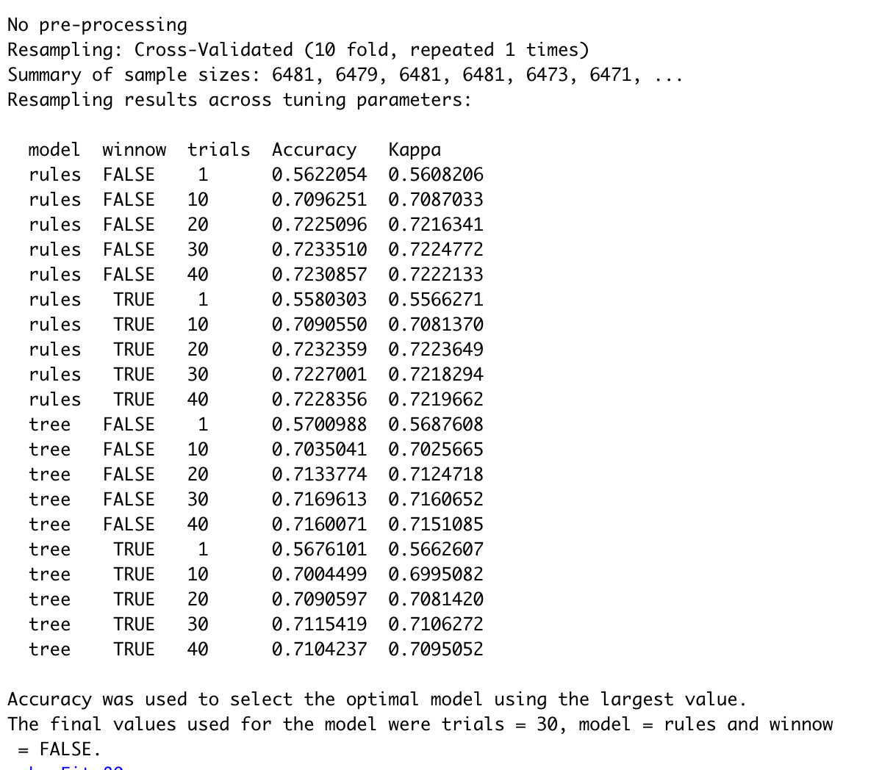
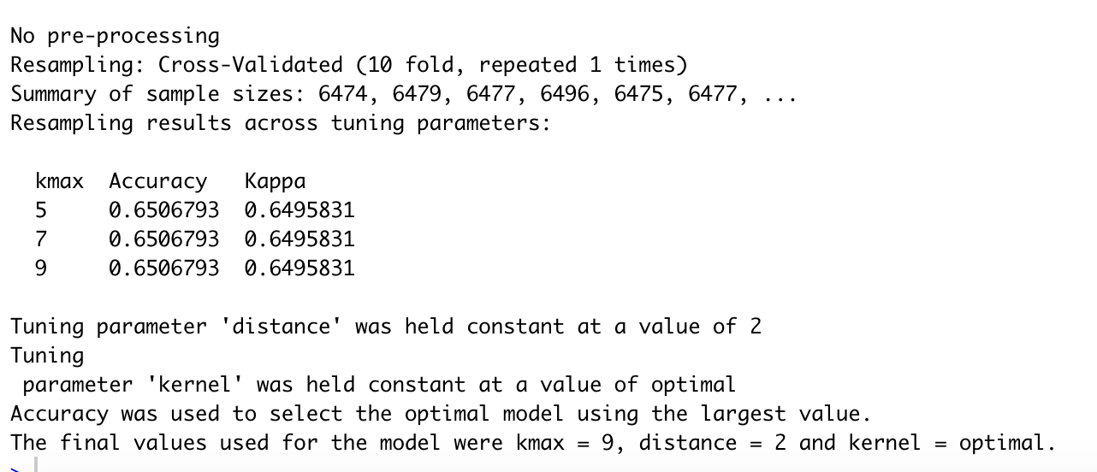
Summary Metrics for Models Using 80% of the WAPs
Random Forest Algorithm – rfFit_80
C5.0 Algorithm – C5Fit_80
k-Nearest Neighbors Algorithm – knnFit_80

Slide 24
Accuracy & Kappa for Models Using 80% of the WAPs
Both plots show the random forest model with a greater accuracy and higher kappa
Dot Plot
Box Plot

Slide 25
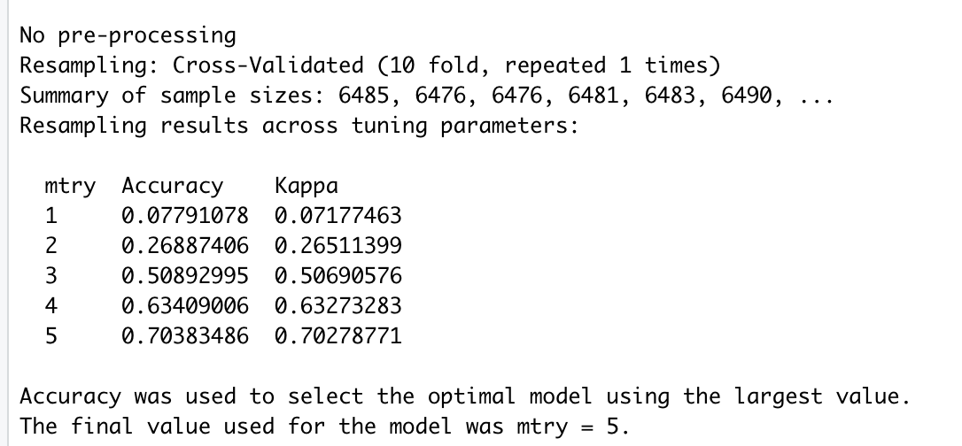
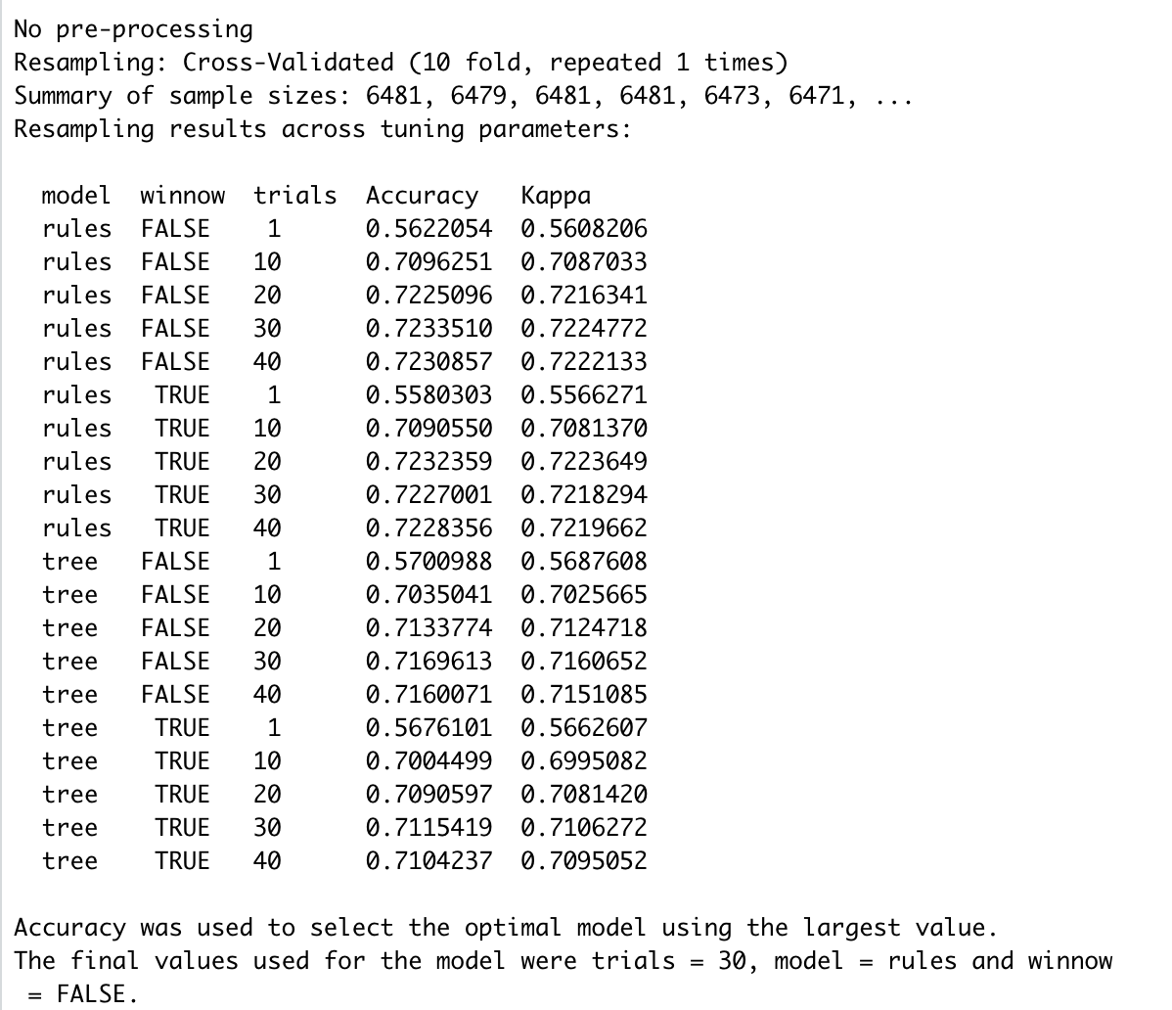
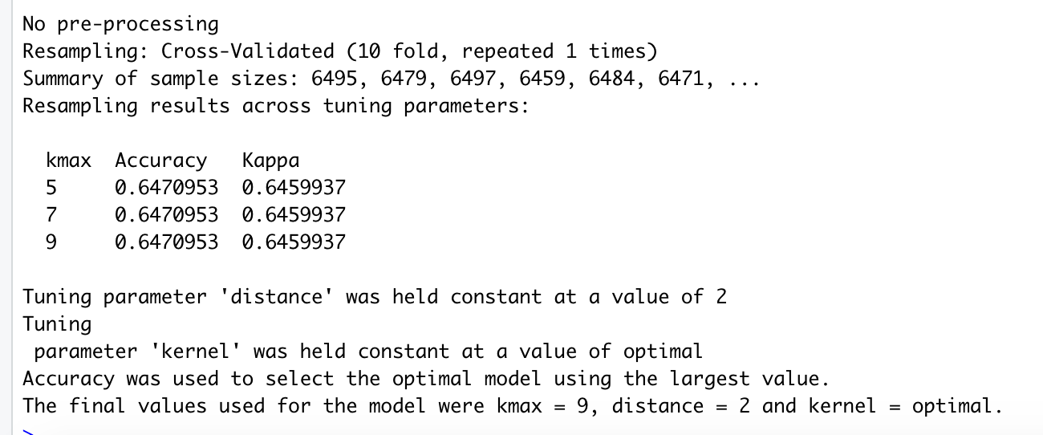
Summary Metrics for Models Using 90% of the WAPs
Random Forest Algorithm – rfFit_90
C5.0 Algorithm – C5Fit_90
k-Nearest Neighbors Algorithm – knnFit_90

Slide 26
Accuracy & Kappa for Models Using 90% of the WAPs
Both plots show the C5.0 model with a greater accuracy and higher kappa
Dot Plot
Box Plot

Slide 27
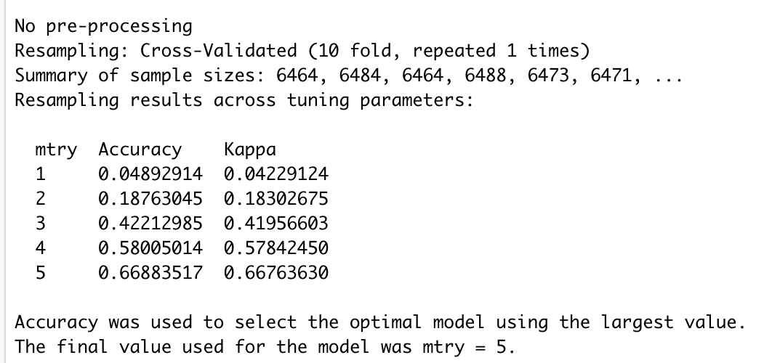
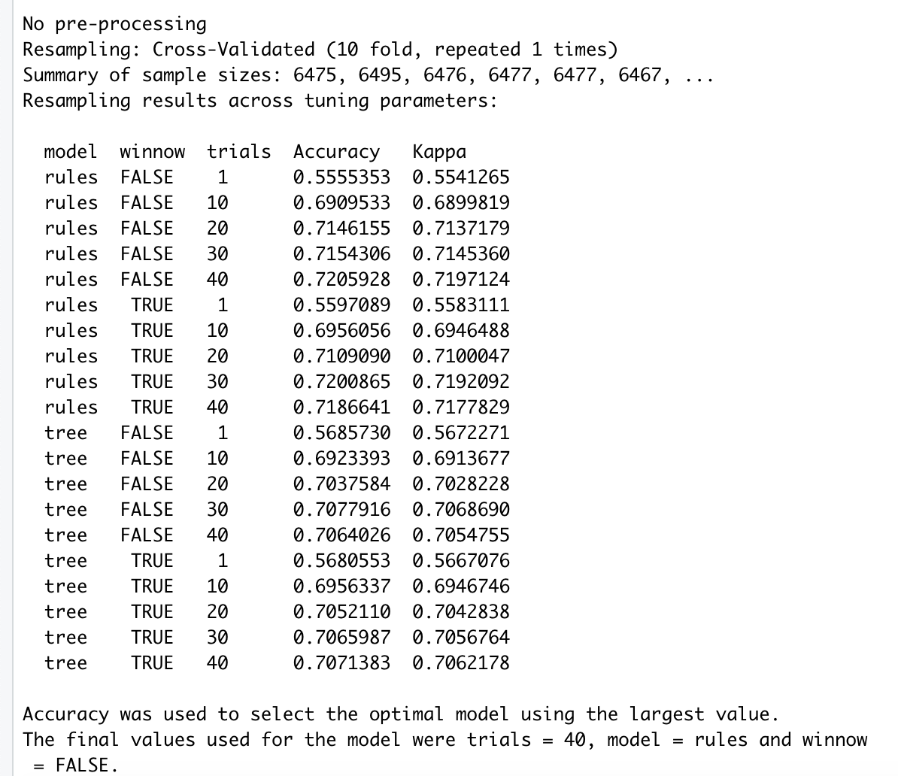
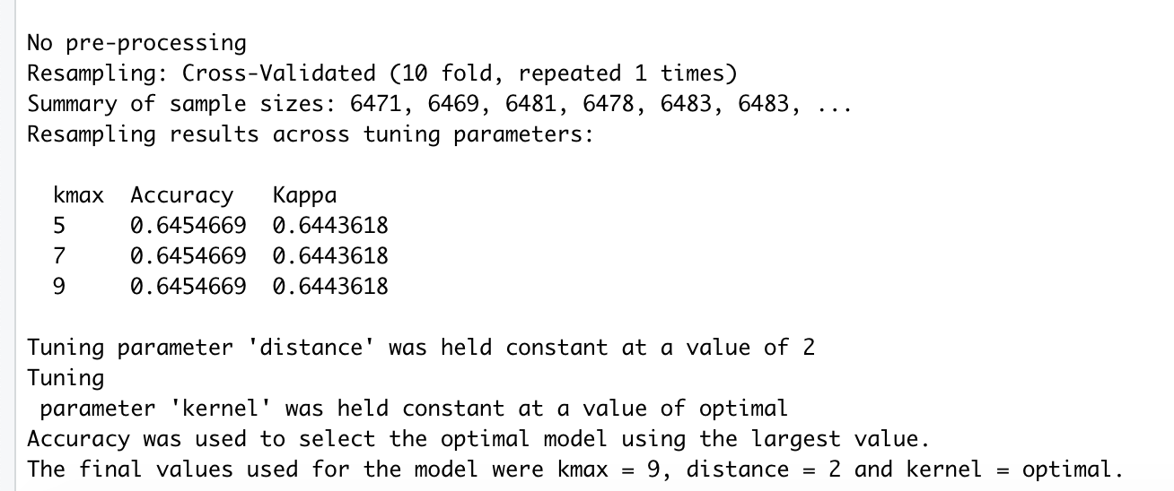
Summary Metrics for Models Using 100% of the WAPs
Random Forest Algorithm – rfFit1
C5.0 Algorithm – C5Fit1
k-Nearest Neighbors Algorithm – knnFit1

Slide 28
Accuracy & Kappa for Models Using 100% of the WAPs
Both plots show the C5.0 model with a greater accuracy and higher kappa
Dot Plot
Box Plot

Slide 29
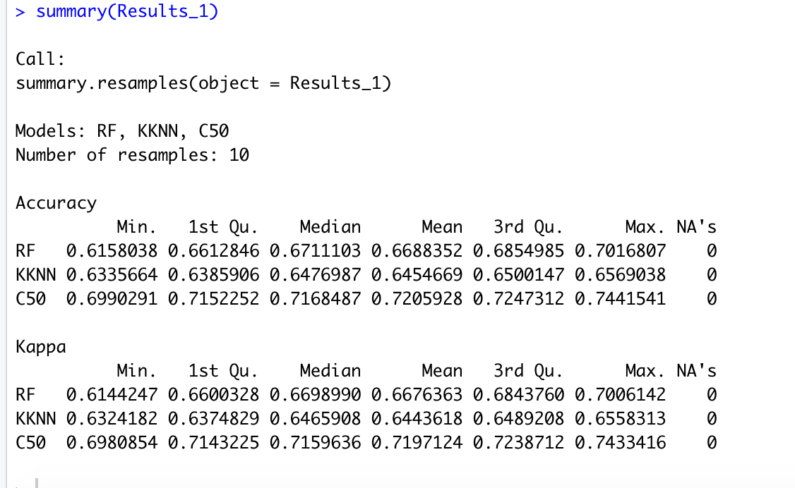
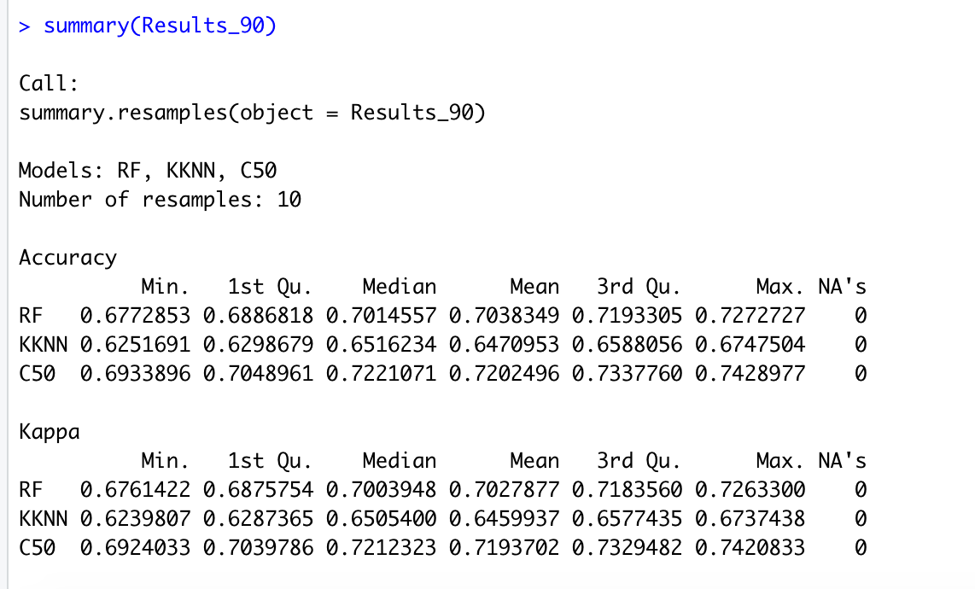
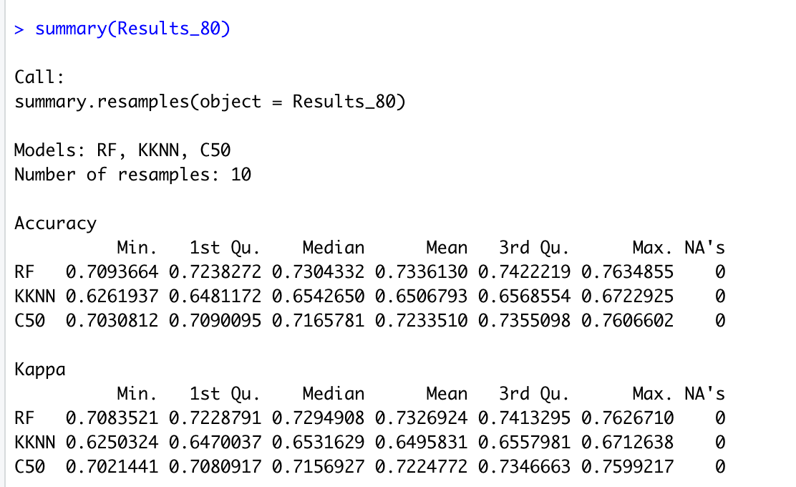
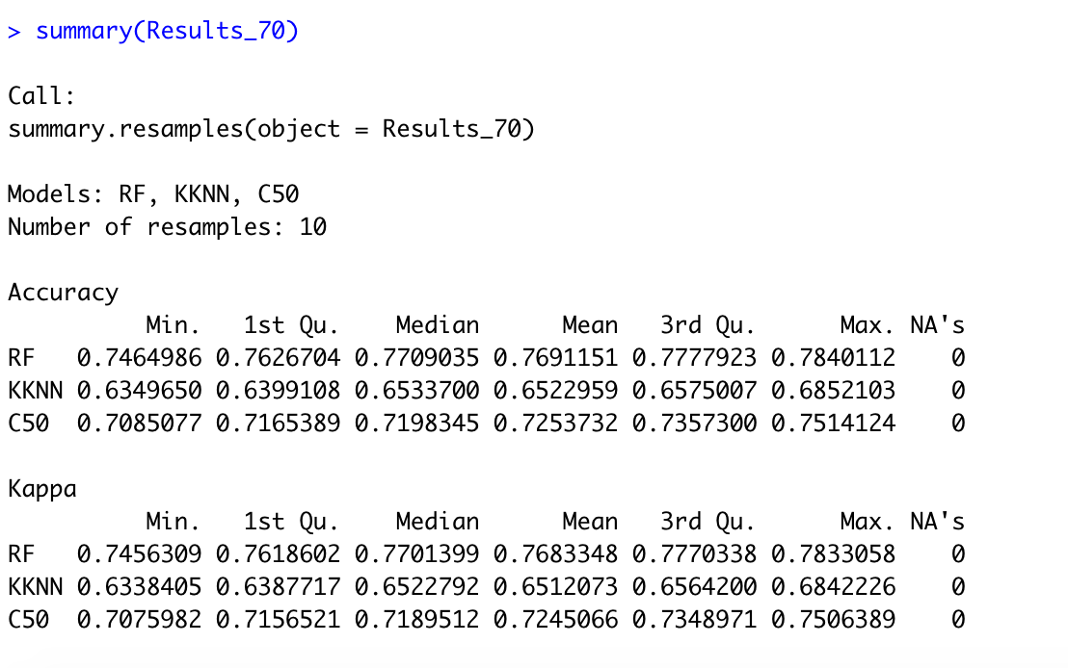
Comparison of Resample Metrics for All Models
Model Chosen
rfFit_70
Justification
Out of the 12 models trained, rfFit_70 has the highest accuracy and kappa metrics

Slide 30
Recommendations for Data Improvement
Employ technology to increase the sensitivity of the WAPs to reduce the number of signals not received
Employ technology that would boost the signal strength of personal devices after an individual enters a building in order to increase the probability of connecting to WAPS

Slide 31
Other Indoor Positioning Techniques
Non-Radio Technologies
Magnetic Positioning
Offers pedestrians with smartphones an indoor accuracy of 1–2 meters with 90% confidence level,
Does not use any additional wireless infrastructure for positioning
Based on the iron inside buildings that create local variations in the Earth's magnetic field
Un-optimized compass chips inside smartphones can sense and record these magnetic variations to map indoor locations
Offers accuracy without any hardware requirements and a relatively low cost of ownership
Position Based on Visual Markers
Can determine the location of a camera-enabled mobile device by decoding location coordinates from visual markers.
Markers are placed at specific locations throughout a venue
Each one encoding that location's coordinates
latitude, longitude and height off the floor.
Measuring the visual angle from the device to the marker enables the device to estimate its own location coordinates in reference to the marker.
Coordinates include latitude, longitude, level and altitude off the floor
Source: Wikipedia Indoor Positioning Systems https://en.wikipedia.org/wiki/Indoor_positioning_system

Slide 32
Other Indoor Positioning Techniques
Channel State Information (CSI)
Channel Impulse Response (CIR) or its Fourier pair, i.e., the Channel Frequency Response (CFR)
Normally delivered to upper layers as channel state information (CSI)
Has higher granularity than the RSS as it can capture both the amplitude and phase responses of the channel in different frequencies and between separate transmitter-receiver antennae pairs
Angle of Arrival (AoA)
use antennae arrays (at the receiver side) to estimate the angle at which the transmitted signal impinges on the receiver by exploiting and calculating the time difference of arrival at individual elements of the antennae array.
Main advantage is that the device/user location can be estimated with as low as two monitors in a 2D environment, or three monitors in a 3D environment
Can provide accurate estimation when the transmitter-receiver distance is small,
Requires more complex hardware and careful calibration compared to RSS techniques
Its accuracy deteriorates with increase in the transmitter-receiver distance
Slight error in the angle of arrival calculation is translated into a huge error in the actual location estimation
Due to multipath effects in indoor environments line of sight (LOS) is often hard to obtain.
Source: “A Survey of Indoor Localization Systems and Technologies”
Written by Faheem Zafari, Student Member, IEEE, Athanasios Gkelias, Senior Member, IEEE, Kin K. Leung, Fellow, IEEE
https://arxiv.org/pdf/1709.01015.pdf

Slide 33
Other Indoor Positioning Techiques
Time of Flight (ToF)
Exploits the signal propagation time to calculate the distance between the transmitter and the receiver
Requires:
Strict synchronization between transmitters and receivers
Timestamps to be transmitted with the signal depending on the underlying communication protocol
Key factors that affect ToF estimation accuracy
Signal bandwidth
Sampling rate
Low sampling rate (in time) reduces the resolution since the signal may arrive between the sampled intervals.
Time Difference of Arrival (TDoA)
Exploits the difference in signals propagation times from different transmitters measured at the receiver
This is different from the ToF technique, where the absolute signal propagation time is used.
TDoA measurements from transmitters are converted into physical distance values
Source: “A Survey of Indoor Localization Systems and Technologies”
Written by Faheem Zafari, Student Member, IEEE, Athanasios Gkelias, Senior Member, IEEE, Kin K. Leung, Fellow, IEEE
https://arxiv.org/pdf/1709.01015.pdf

Slide 34
Other Indoor Positioning Techniques
Return Time of Flight (RToF)
Measures the round-trip (i.e., transmitter-receiver- transmitter) signal propagation time to estimate the distance between transmitter and receiver.
Similar to ToF
Upon receiving a signal from the transmitter, the receiver responds back to the transmitter which then calculates the total round-trip ToF
Main benefit
Relatively moderate clock synchronization between transmitter and receiver is required
Phase of Arrival (PoA)
Uses the phase or phase difference of carrier signal to estimate the distance between the transmitter and the receiver
Source: “A Survey of Indoor Localization Systems and Technologies”
Written by Faheem Zafari, Student Member, IEEE, Athanasios Gkelias, Senior Member, IEEE, Kin K. Leung, Fellow, IEEE
https://arxiv.org/pdf/1709.01015.pdf

Slide 35
Appendix of R Code Used

Slide 36
General R Code Used
Code ran before the models were trained
set.seed(123)
library(readr)
library(caret)
library(do_parallel)
Parallel processing was set up using the following
cl1 <- makeCluster(3)
registerDoParallel(cl1)
getDoParWorkers()
RF tuning grid used on all random forest models
rfGrid <- expand.grid(mtry=c(1,2,3,4,5))

Slide 37
Dataframe using 70% of the WAPs
Bldg2_70 <- read.csv("trainingData - 70%.csv")
Creating the dependent variable
Bldg2_70 <- cbind(Bldg2_70,paste(Bldg2_70$BUILDINGID,Bldg2_70$FLOOR,Bldg2_70$SPACEID,Bldg2_70$RELATIVEPOSITION),stringsAsFactors=FALSE)
Renaming the column
colnames(Bldg2_70)[148] <- "BldgFlrRmRp”
Moving the dependent variable column to the front of the data frame
Bldg2_70 <- Bldg2_70[,c(ncol(Bldg2_70), 1:(ncol(Bldg2_70)-1))]
Removing attributes no longer needed
Bldg2_70$FLOOR <- NULL
Bldg2_70$BUILDINGID <- NULL
Bldg2_70$SPACEID <- NULL
Bldg2_70$RELATIVEPOSITION <- NULL

Slide 38
Models Using 70% of the WAPs
Setting up training and testing frames needed
inTraining_70 <- createDataPartition(Bldg2_70$BldgFlrRmRp, p=.75, list=FALSE)
training_70 <- Bldg2_70[inTraining_70,]
testing_70 <- Bldg2_70[-inTraining_70,]
Models
Random Forest
rfFit_70 <- train(BldgFlrRmRp~., data = training_70, method = "rf", trControl=fitControl, tuneGrid=rfGrid
C5.0
C5Fit_70 <- train(BldgFlrRmRp~., data = training_70, method = "C5.0", trControl=fitControl, tuneLength = 5)
KNN
knnFit_70 <- train(BldgFlrRmRp~., data = training_70, method = "kknn", trControl=fitControl, k=5)

Slide 39
Dataframe using 80% of the WAPs
Bldg2_80 <- read.csv("trainingData - 80%.csv")
Creating the dependent variable
Bldg2_80 <- cbind(Bldg2_80,paste(Bldg2_80$BUILDINGID,Bldg2_80$FLOOR,Bldg2_80$SPACEID,Bldg2_80$RELATIVEPOSITION),stringsAsFactors=FALSE)
Renaming the column
colnames(Bldg2_80)[168] <- "BldgFlrRmRp”
Moving the dependent variable column to the front of the data frame
Bldg2_80 <- Bldg2_80[,c(ncol(Bldg2_80), 1:(ncol(Bldg2_80)-1))]
Removing attributes no longer needed
Bldg2_80$FLOOR <- NULL
Bldg2_80$BUILDINGID <- NULL
Bldg2_80$SPACEID <- NULL
Bldg2_80$RELATIVEPOSITION <- NULL

Slide 40
Models Using 80% of the WAPs
Setting up training and testing frames needed
inTraining_80 <- createDataPartition(Bldg2_80$BldgFlrRmRp, p=.75, list=FALSE)
training_80 <- Bldg2_80[inTraining_80,]
testing_80 <- Bldg2_80[-inTraining_80,]
Models
Random Forest
rfFit_80 <- train(BldgFlrRmRp~., data = training_80, method = "rf", trControl=fitControl, tuneGrid=rfGrid
C5.0
C5Fit_80 <- train(BldgFlrRmRp~., data = training_80, method = "C5.0", trControl=fitControl, tuneLength = 5)
KNN
knnFit_80 <- train(BldgFlrRmRp~., data = training_80, method = "kknn", trControl=fitControl, k=5)

Slide 41
Dataframe using 90% of the WAPs
Bldg2_90 <- read.csv("trainingData - 90%.csv")
Creating the dependent variable
Bldg2_90 <- cbind(Bldg2_90,paste(Bldg2_90$BUILDINGID,Bldg2_90$FLOOR,Bldg2_90$SPACEID,Bldg2_90$RELATIVEPOSITION),stringsAsFactors=FALSE)
Renaming the column
colnames(Bldg2_90)[188] <- "BldgFlrRmRp”
Moving the dependent variable column to the front of the data frame
Bldg2_90 <- Bldg2_90[,c(ncol(Bldg2_90), 1:(ncol(Bldg2_90)-1))]
Removing attributes no longer needed
Bldg2_90$FLOOR <- NULL
Bldg2_90$BUILDINGID <- NULL
Bldg2_90$SPACEID <- NULL
Bldg2_90$RELATIVEPOSITION <- NULL

Slide 42
Models Using 90% of the WAPs
Setting up training and testing frames needed
inTraining_90 <- createDataPartition(Bldg2_90$BldgFlrRmRp, p=.75, list=FALSE)
training_90 <- Bldg2_90[inTraining_90,]
testing_90 <- Bldg2_90[-inTraining_90,]
Models
Random Forest
rfFit_90 <- train(BldgFlrRmRp~., data = training_90, method = "rf", trControl=fitControl, tuneGrid=rfGrid
C5.0
C5Fit_90 <- train(BldgFlrRmRp~., data = training_90, method = "C5.0", trControl=fitControl, tuneLength = 5)
KNN
knnFit_90 <- train(BldgFlrRmRp~., data = training_90, method = "kknn", trControl=fitControl, k=5)

Slide 43
Dataframe using 100% of the WAPs
Bldg2TrData <- read.csv("Bldg2 Training Data.csv")
Creating the dependent variable
Bldg2TrData <- cbind(Bldg2TrData,paste(Bldg2TrData$BUILDINGID,Bldg2TrData$FLOOR,Bldg2TrData$SPACEID,Bldg2TrData$RELATIVEPOSITION),stringsAsFactors=FALSE)
Renaming the column
colnames(Bldg2TrData)[208] <- "BldgFlrRmRp”
Moving the dependent variable column to the front of the data frame
Bldg2TrData <- Bldg2TrData[,c(ncol(Bldg2TrData), 1:(ncol(Bldg2TrData)-1))]
Removing attributes no longer needed
Bldg2TrData$FLOOR <- NULL
Bldg2TrData$BUILDINGID <- NULL
Bldg2TrData$SPACEID <- NULL
Bldg2TrData$RELATIVEPOSITION <- NULL

Slide 44
Models Using 100% of the WAPs
Setting up training and testing frames needed
inTraining <- createDataPartition(Bldg2TrData$BldgFlrRmRp, p=.75, list=FALSE)
training <- Bldg2TrData [inTraining,]
testing <- Bldg2TrData [-inTraining,]
Models
Random Forest
rfFit1 <- train(BldgFlrRmRp~., data = training, method = "rf", trControl=fitControl, tuneGrid=rfGrid
C5.0
C5Fit1 <- train(BldgFlrRmRp~., data = training, method = "C5.0", trControl=fitControl, tuneLength = 5)
KNN
knnFit1 <- train(BldgFlrRmRp~., data = training, method = "kknn", trControl=fitControl, k=5)

Slide 45
Metrics
Summary Metrics
Simply type the model name to get the accuracy and kappa metrics
Type “rfFit_70” to get the following:
Comparing Models through Resampling
Results_70 <-
resamples(list(RF = rfFit_70, KKNN = knnFit_70, C50 = C5Fit_70))
Type “summary(Results_70)” to get the following:

Slide 46
Plots
Dot Plot
Type “dotplot(Results_70)” to get the following
Box Plot
Type “bwplot(Results_70)” to get the following

Slide 47


